Slide 1
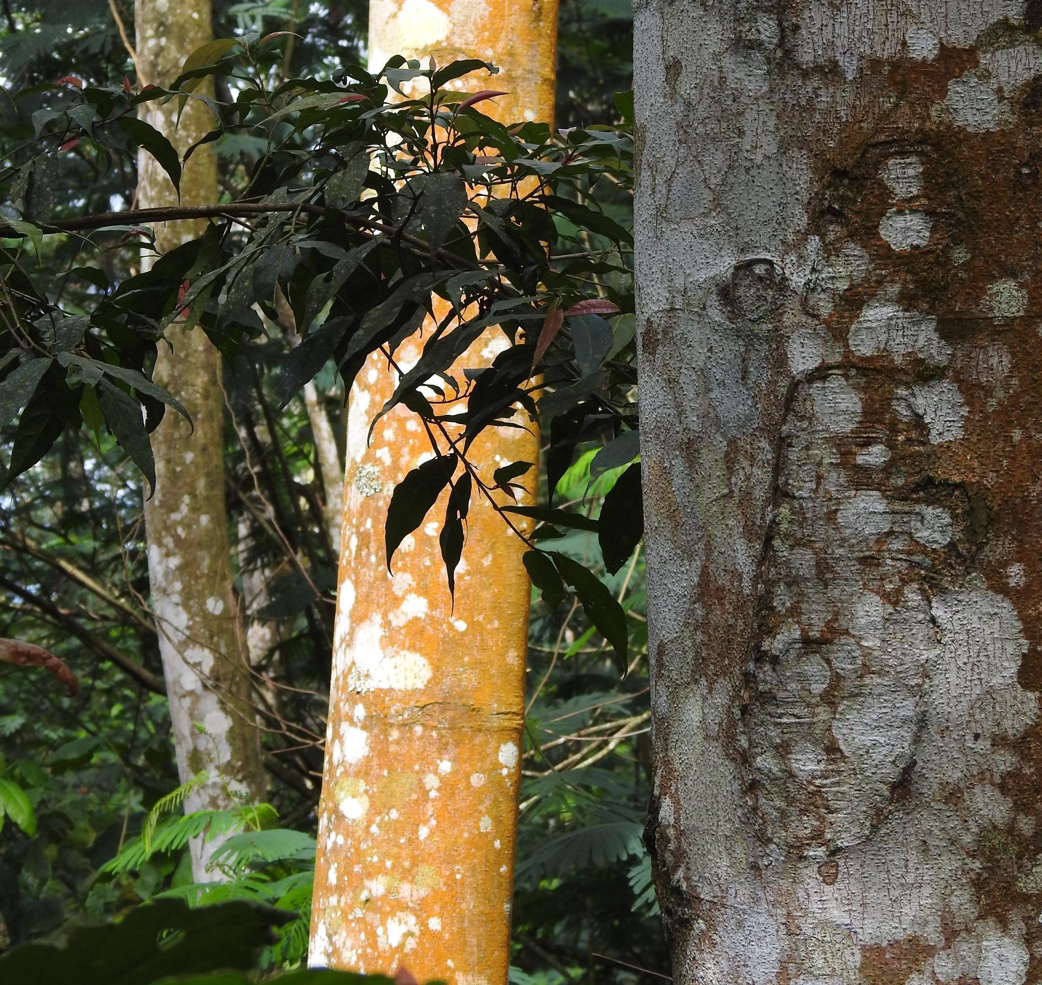
EU regulatory approach to prevent deforestation and forest degradation at a global scale
Nicolas de Sadeleer, Full Professor, Jean Monnet chair
Gauthier Martens, PhD Researcher

Slide 2
Table of Content
I. Introductory comments
II. Sources of international law aiming at forest conservation
III. EU legal instruments on forest conservation
IV. 2023 EU Forest Risk Commodities Regulation
V. Conclusions

Slide 3
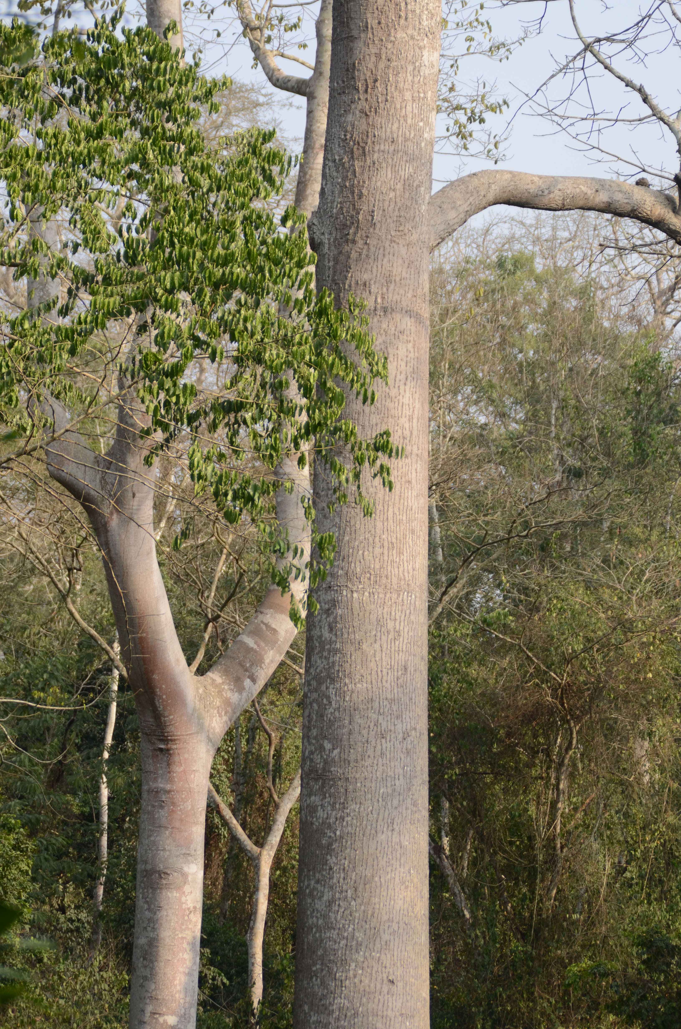
I. Introductory comments
Scientific/legal definitions of a forest, an ecosystem, an habitat, a species
Main forest habitats
Ecosystem services provided by forests
Drivers of deforestation and forest degradation

Slide 4
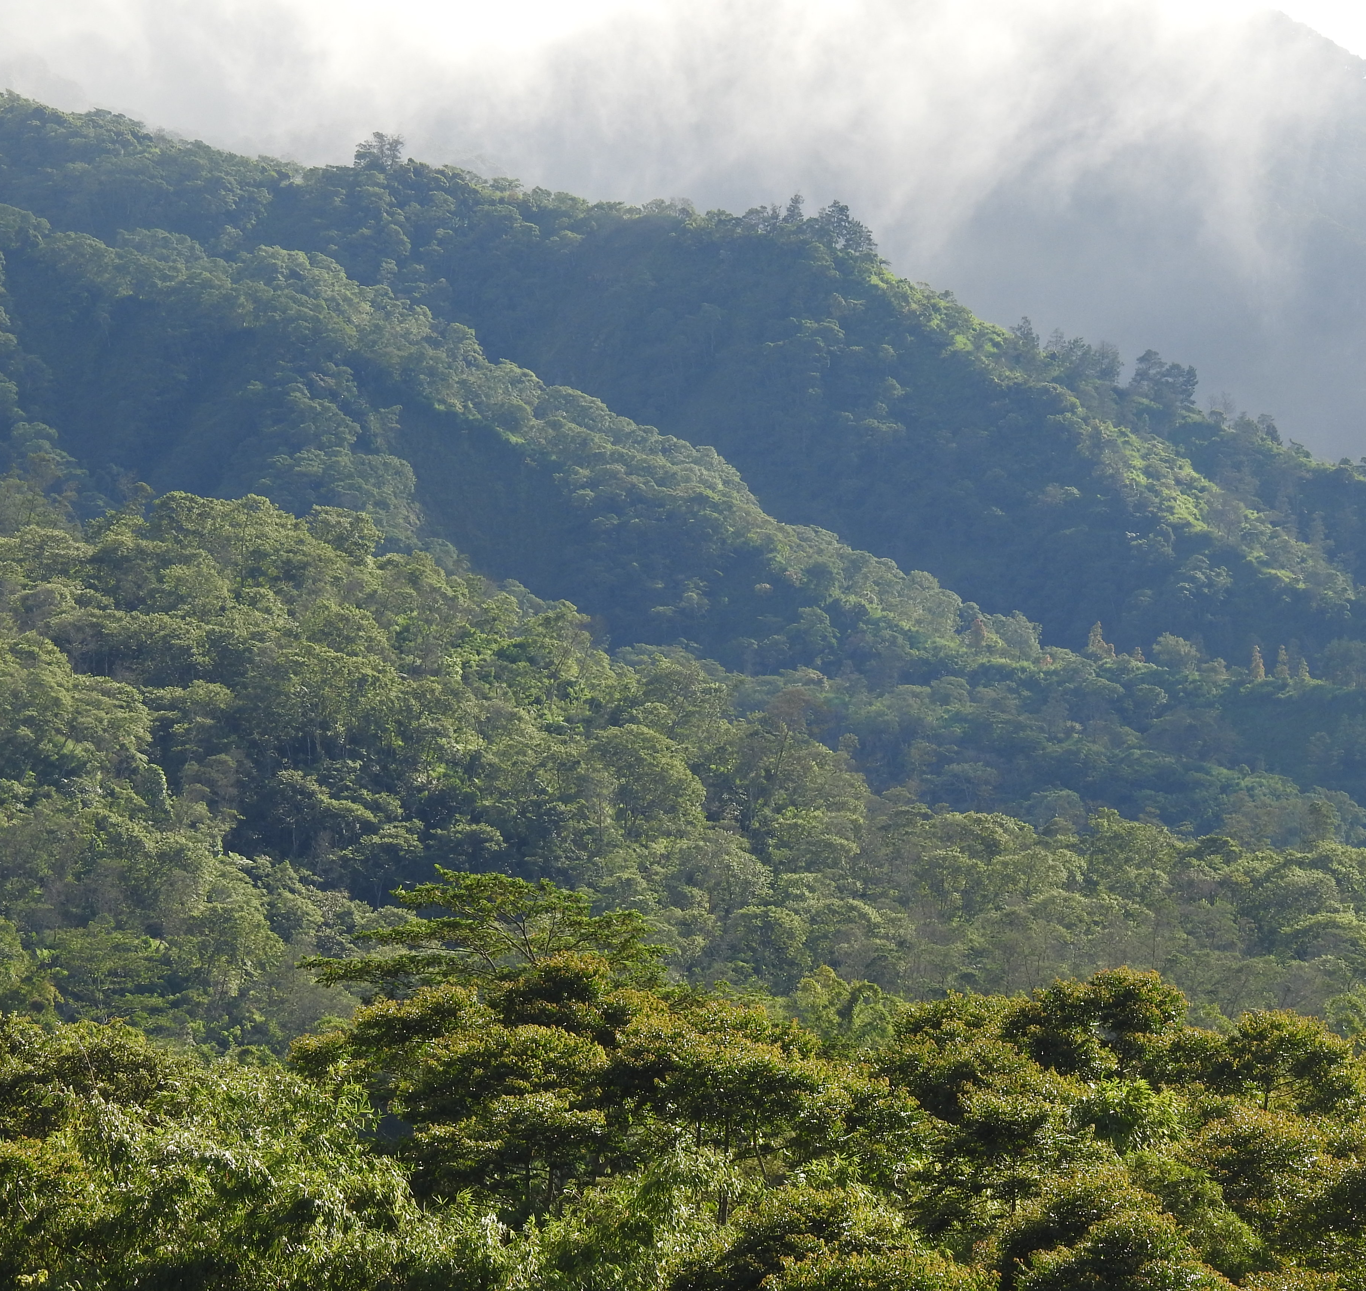
Scientific definition of a forest
« Communauté vivante, constituée par un certain nombre de population végétales et animales liées par des relations intra–et interspécifiques. Cet ensemble structuré et fonctionnel constitue un écosystème. »
– Encyclopedia universalis. Dictionnaire de l’écologie, Paris, Albin-Michel, 604

Slide 5
What is an ecosystem?
An ecosystem is a community of living organisms (plants, animals and microbes) in conjunction with the non-living components of their environment (things like air, water and mineral soil), interacting as a system.
1992 Convention on Biological Diversity (CBD): the ecosystem is defined as “a dynamic complex of plant, animal and micro-organism communities and their non-living environment interacting as a functional unit”.

Slide 6
Main forest habitats
Tropical forest: The natural and semi-natural tropical or subtropical forest ecosystems, whether primary or secondary, whether closed or open forests, in both dry and humid areas. The areas concerned are those found within the tropics and subtropics delimited by the 30th northern and southern parallels.
Temperate forest: Mixed forest of conifers and broad-leaf deciduous trees, or mixed conifer and broad-leaf evergreen trees, or entirely broad-leaf deciduous, or entirely broad-leaf evergreen trees, found in temperate regions across the world; characterized by high rainfall, warm summers, cold winters occasionally subzero, seasonality; typically with dense canopies, understorey saplings and tall shrubs, large animals, carnivores dominant, very rich in bird species.
Boreal forest: The northern hemisphere, circumpolar, tundra forest type consisting primarily of black spruce and white spruce with balsam fir, birch and aspen.
Mangrove forest: A community of salt-tolerant trees and shrubs, with many other associated organisms, that grows on some tropical and sub-tropical coasts in a zone roughly coinciding with the intertidal zone.
(European Environment Agency’s online glossary)

Slide 7
What is an habitat?
Article 2 CBD: “Habitat” means the place or type of site where an organism or population naturally occurs.
Article 1 Habitats Directive: habitat of a species means an environment defined by specific abiotic and biotic factors, in which the species lives at any stage of its biological cycle.

Slide 8
Forest habitats under Annex I of the 1992 Habitats Directive
“(Sub)natural woodland vegetation comprising native species forming forests of tall trees, with typical undergrowth, and meeting the following criteria: rare or residual, and/or hosting species of Community interest.”
90. Forests of Boreal Europe
91. Forests of temperate Europe
92. Mediterranean deciduous forests
93. Mediterranean sclerophyllous forests
94. Temperate mountainous coniferous forests
95. Mediterranean and Macaronesian mountainous coniferous forests

Slide 9
What is a species?
Art. 1(g) Habitats directive:
“Species of EU interest means species which (…) are:
(i) endangered, except those species whose natural range is marginal in that territory and which are not endangered or vulnerable in the western palearctic region; or
(ii) vulnerable, i.e. believed likely to move into the endangered category in the near future if the causal factors continue operating; or
(iii) rare, i.e. with small populations that are not at present endangered or vulnerable, but are at risk.
(iv) endemic, and requiring particular attention by reason of the specific nature of their habitat and/or the potential impact of their exploitation on their habitat and/or the potential impact of their exploitation on their conservation status.”

Slide 10
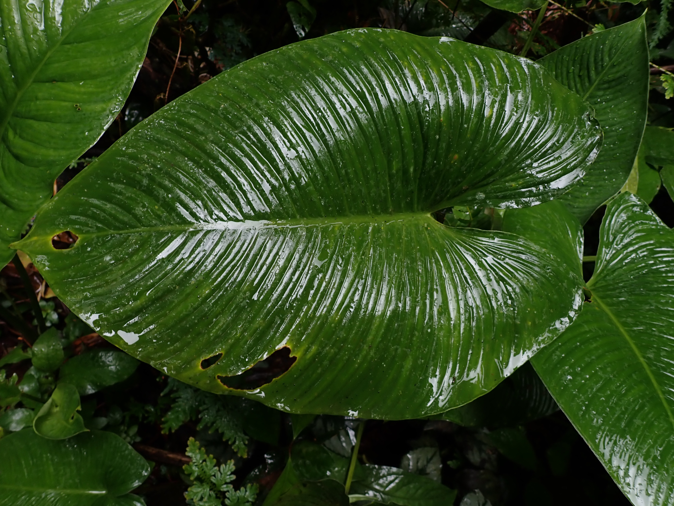
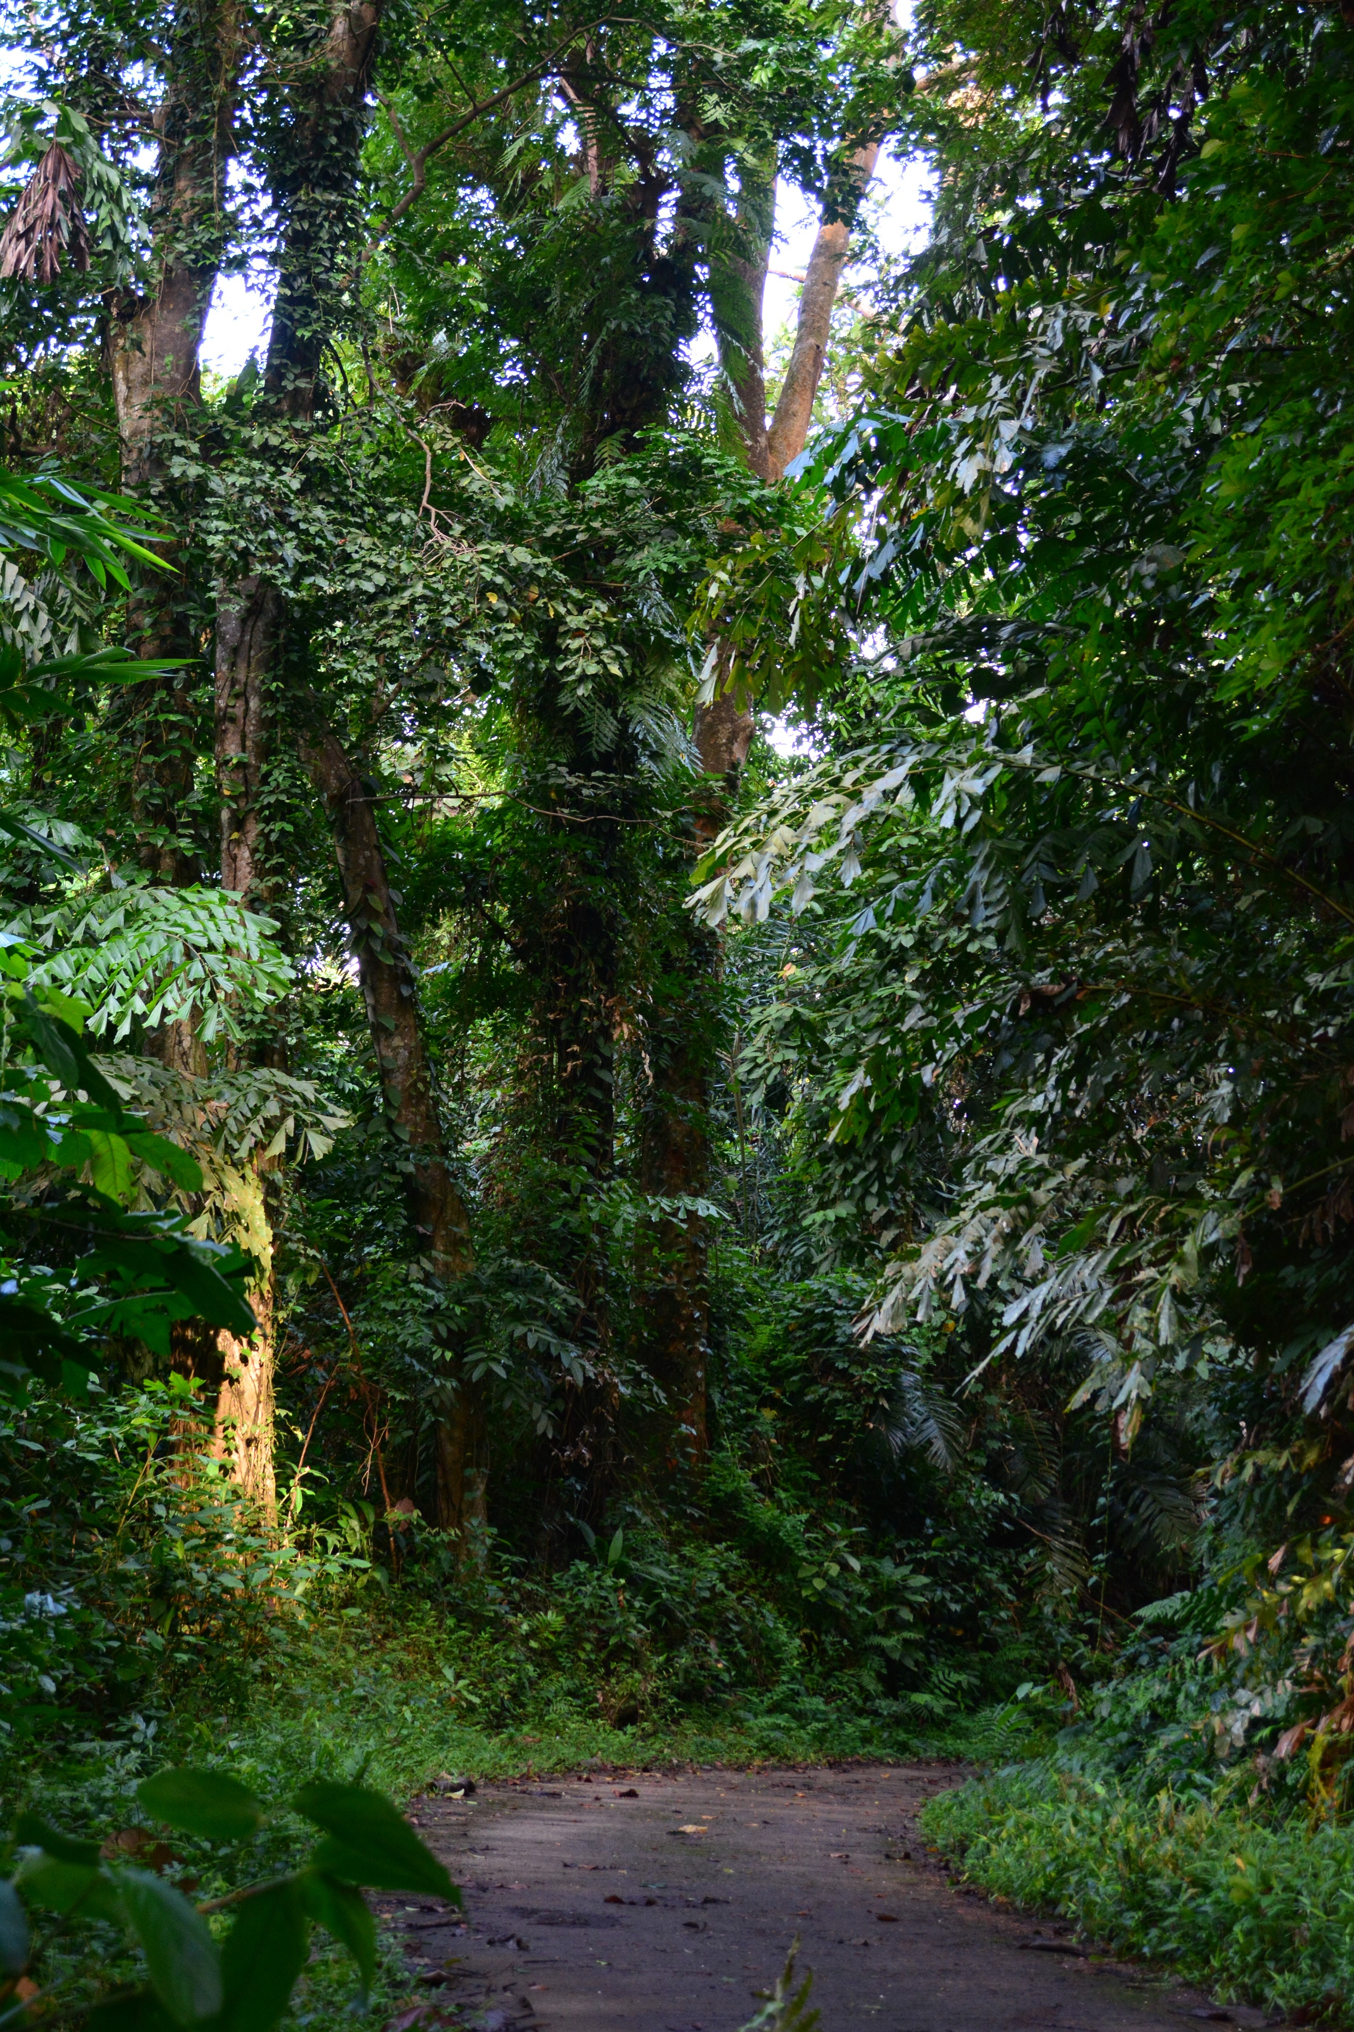
Convention on International Trade in Endangered Species of Wild Fauna and Flora
Article I (a): “Species” means any species, subspecies, or geographically separate population thereof

Slide 11
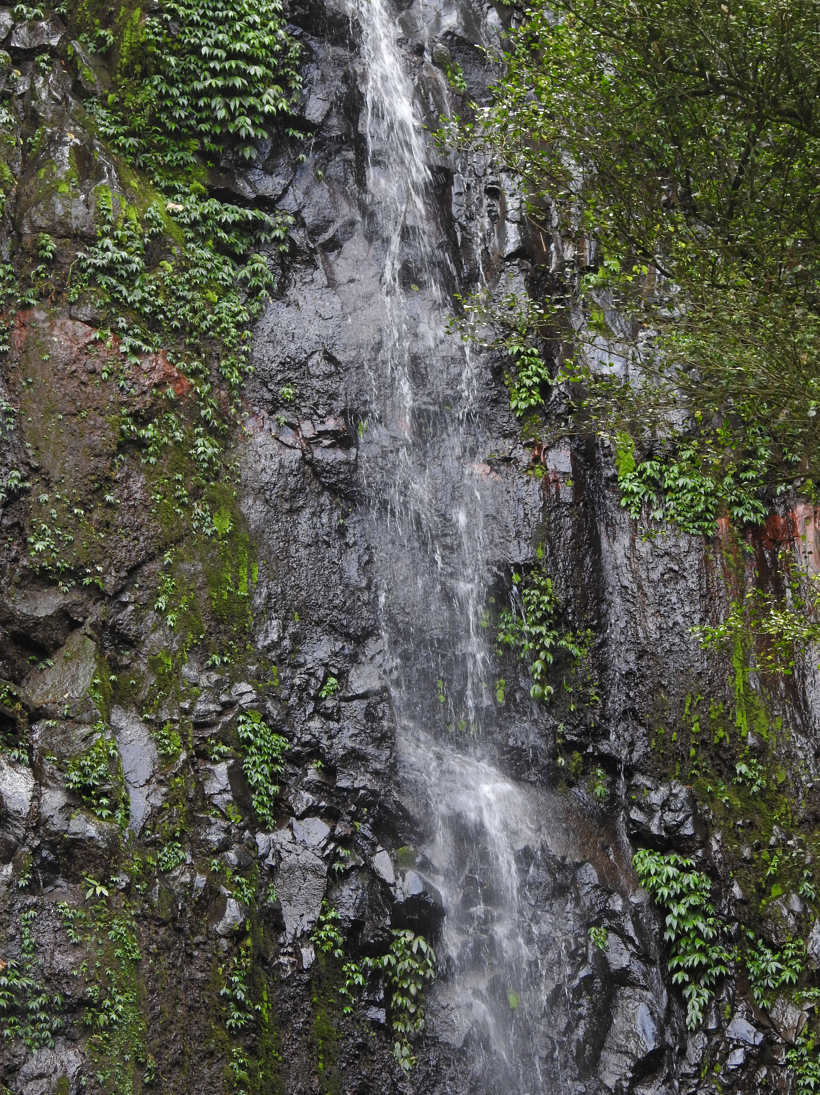
Ecosystem services provided by forests
food, fuel and fibre,
clean the air,
filter water supplies,
control floods and erosion,
sustain biodiversity and genetic resources,
provide opportunities for recreation, education, and cultural enrichment.

Slide 12
Deforestation and forest degradation
FAO: 20 million hectares of forest – about 10% of the world’s remaining forests and an area larger than the European Union – have been lost worldwide between 1990 and 2020 (FAO (2020), Global Forest Resource Assessment 2020: Main Report, p. XII)
Every year the world continues to lose 10 million hectares of forest.
Deforestation and forest degradation are drivers of global warming and biodiversity loss — the two most important environmental challenges of our time.

Slide 13
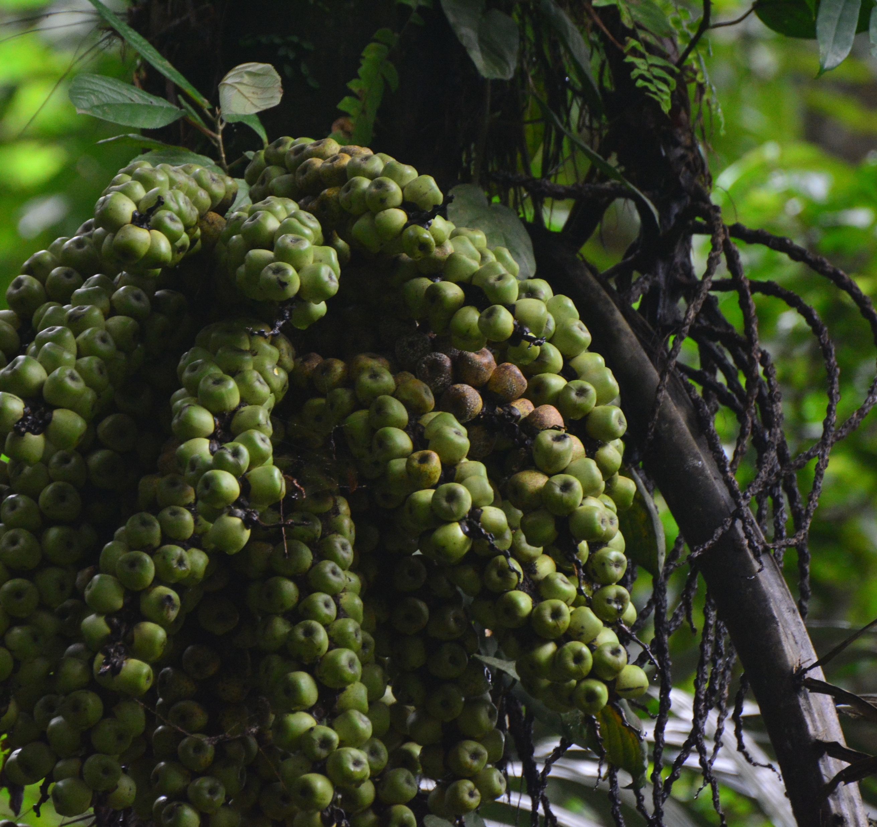
Drivers of deforestation and forest degradation
Agricultural expansion drives almost 90% of global deforestation, with more than half of forest loss due to conversion of forest into cropland, whereas livestock grazing is responsible for almost 40 percent of forest loss
Palm oil fruit, Carita, Java

Slide 14
II. Sources of international law aiming at forest conservation
A. Treaty Law
B. Soft Law
C. Institutional actors

Slide 15
Sources of international law aiming at forest conservation
Treaty Law: No framework agreement on forest protection
1983 International Tropical Timber Agreement (ITTA) provides an effective framework for cooperation between tropical timber producers and consumers and to encourage the development of national policies aimed at sustainable utilization and conservation of tropical forests.
The question of protecting forests under an international binding convention has challenged nations like few other environmental issues and dominated much of the “United Nations Conference on Environment and Development” (UNCED) in 1992.

Slide 16
A. Treaty Law
Environmental Multilateral Agreements applicable to forest ecosystems:
1972 UNESCO Convention concerning the Protection of World Cultural and Natural Heritage
1973 Washington Convention on International Trade in Endangered Species of Wild Fauna and Flora
1971 Ramsar Convention on Wetlands of International Importance Especially as Waterfowl Habitat
1992 Convention on Biological Diversity
1994 UN Convention to Combat Desertification

Slide 17
CITES
Each Party must establish a Management Authority and at least one Scientific Authority, and trade is regulated by means of a permit system.
Appendix I listed species: trade in principle prohibited;
Appendix II listed species: For a country to export a specimen of a species listed in Appendix II, which is the majority of tree species, the Management Authority has to confirm that the species has been harvested sustainably as well as in accordance with all relevant national legislation;
Appendix III listed species: Identified by a State party as being the subject of regulation within its jurisdiction for the purpose of preventing or restricting exploitation, and for which the control of trade requires cooperation from other Parties.

Slide 18
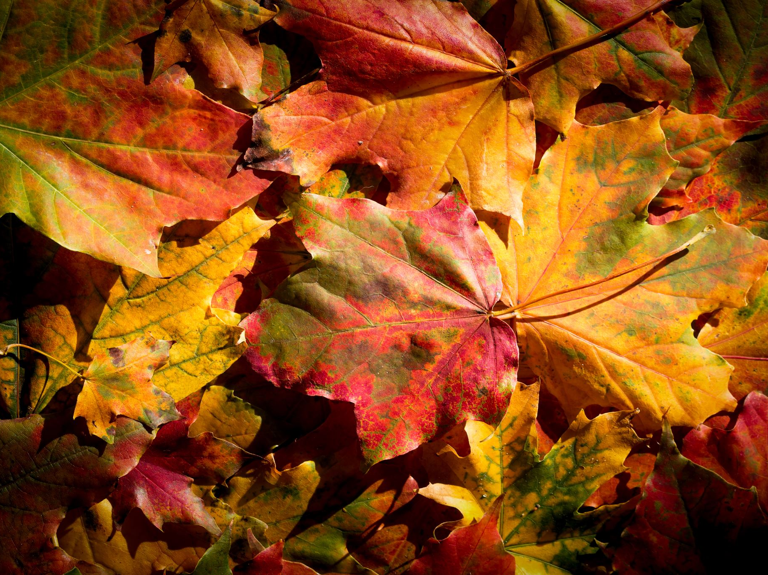
Regional agreements applicable to forest ecosystems:
Council of Europe Convention on the conservation of European wildlife and natural habitats
Group of Experts on Protected Areas and Ecological Networks, Interpretation manual of the habitats listed in Resolution No. 4 (1996) listing endangered natural habitats requiring specific conservation measures (Strasbourg, 2015)

Slide 19
B. Soft Law
1. International Soft law
1992 Non-legally Binding Authoritative Statement of Principles for a Global Consensus on Management, Conservation and Sustainable Development of All Types of Forests (Rio Forest Principles)
SDG 15.2: promote the implementation of sustainable management of all types of forests, halt deforestation, restore degraded forests and substantially increase afforestation and reforestation globally
Aichi Targets 5 and 7
UN Strategic Plan for Forests 2017-2030
Glasgow Leaders’ Declaration on Forests and Land Use

Slide 20
B. Soft Law
2. EU Soft Law
Stepping Up EU Action to Protect and Restore the World’s Forests (COM(2019) 352 final)
New EU Forest Strategy for 2030 (COM(2021) 572 final)
Point 2.1 Promoting sustainable forest bioeconomy for long-lived wood products: Within the boundaries of sustainable availability and supply of wood, the forest-based sector holds significant economic potential for improving its production of sustainable and legally harvested wood for circular and long-lived materials and products.

Slide 21
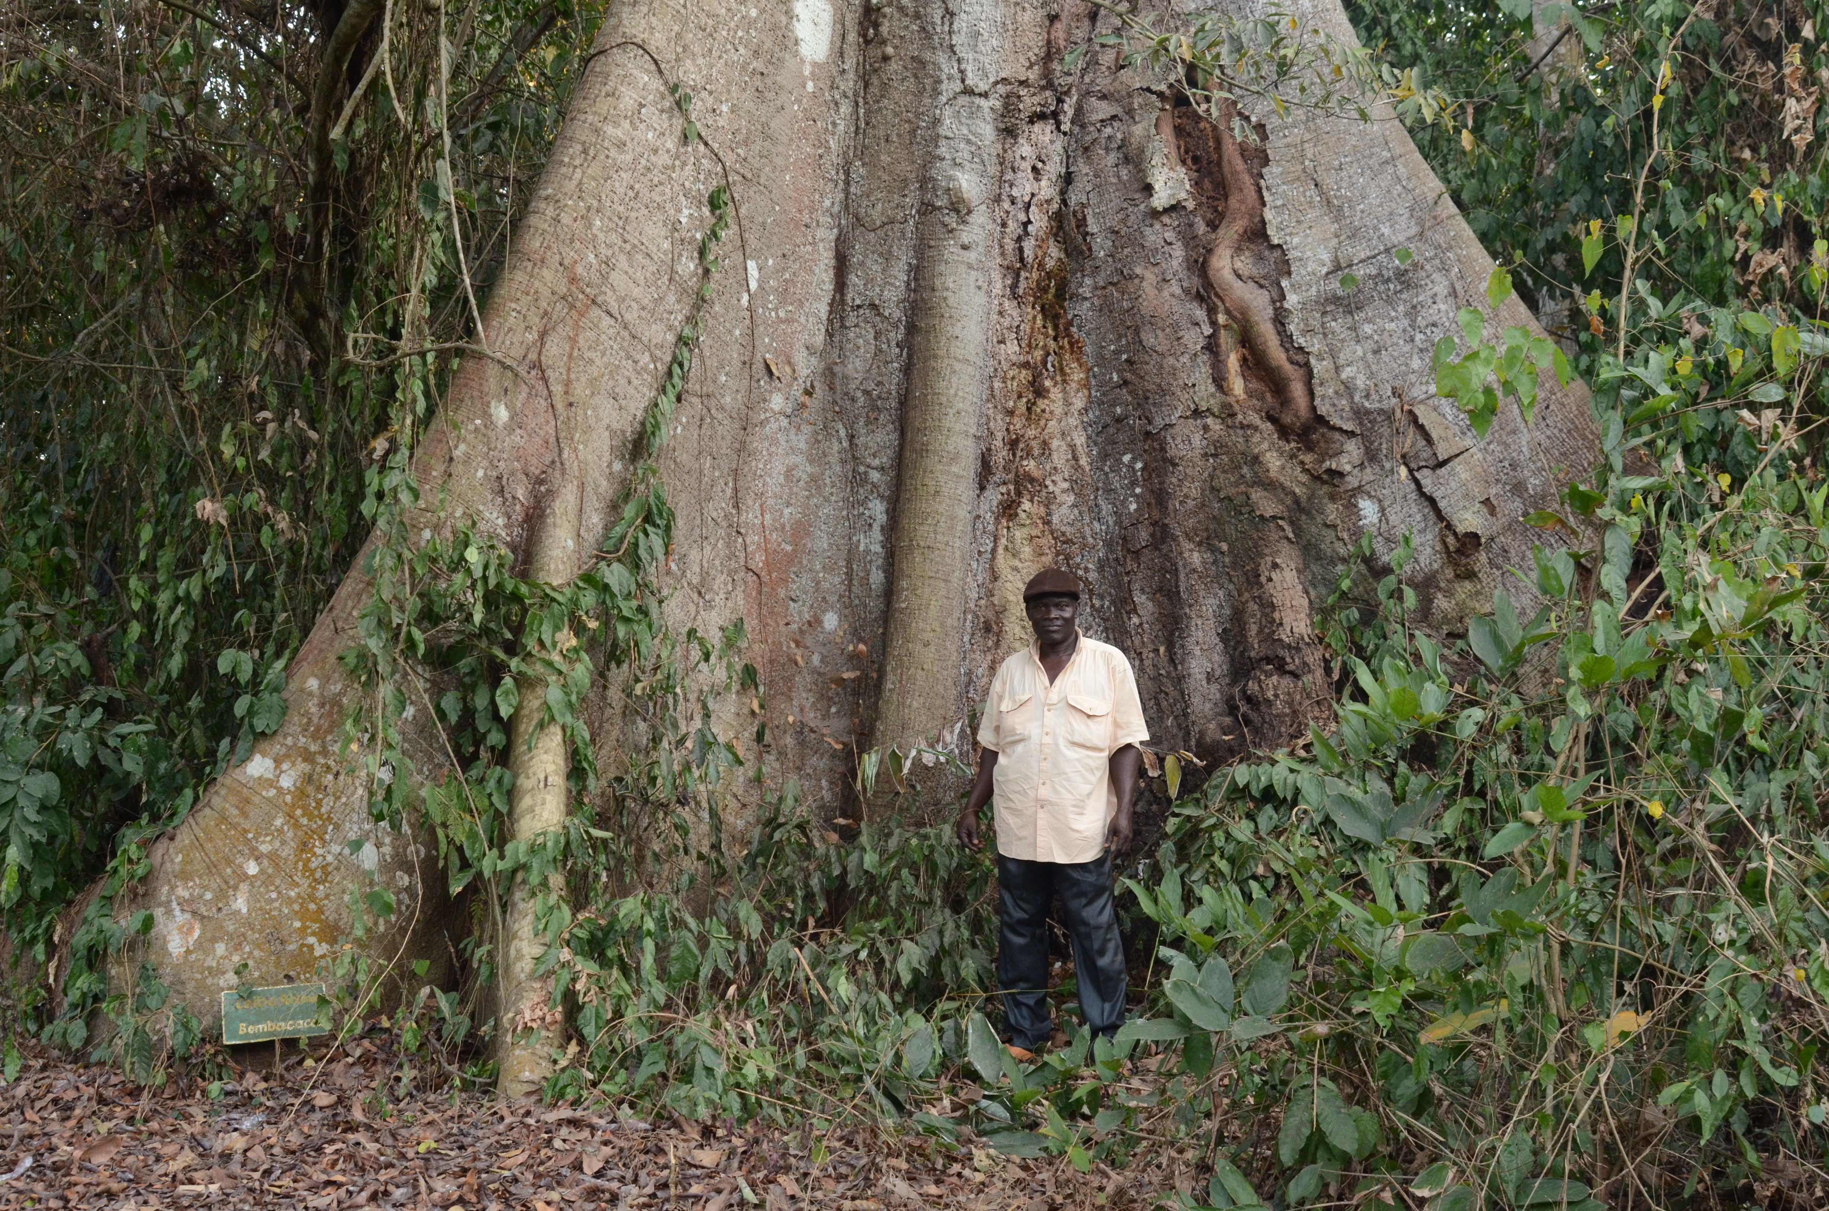
C. Institutional Actors
United Nations Forum on Forests (UNFF; since 2000)
Intergovernmental Panel on Forests (IPF; 1995-1997)
Intergovernmental Forum on Forests (IFF; 1997-2000)
Collaborative Partnership on Forests (CPF)
Successor to Interagency Task Force on Forests (ITFF)
Objective to support the UNFF and its member countries and to enhance cooperation and coordination on forest issues.
Comprises 16 International Organisations:
CIFOR, CBD, CITES, FAO, GEF, GCF, ITTO, IUCN, IUFRO, UNCCD, UNDP, UNEP, UNFF, UNFCCC, World Agroforestry, World Bank
Tropical forest buttress tree, Benin

